Slide 1
Building Custom Vue.js Services and Plugins
Kevin Griffin
@1kevgriff

Slide 2

About Me
Kevin Griffin
10x Microsoft MVP
ASP.NET Core, Azure, and Web
consultwithgriff.com
twitter.com/1kevgriff
twitch.com/1kevgriff

Slide 3
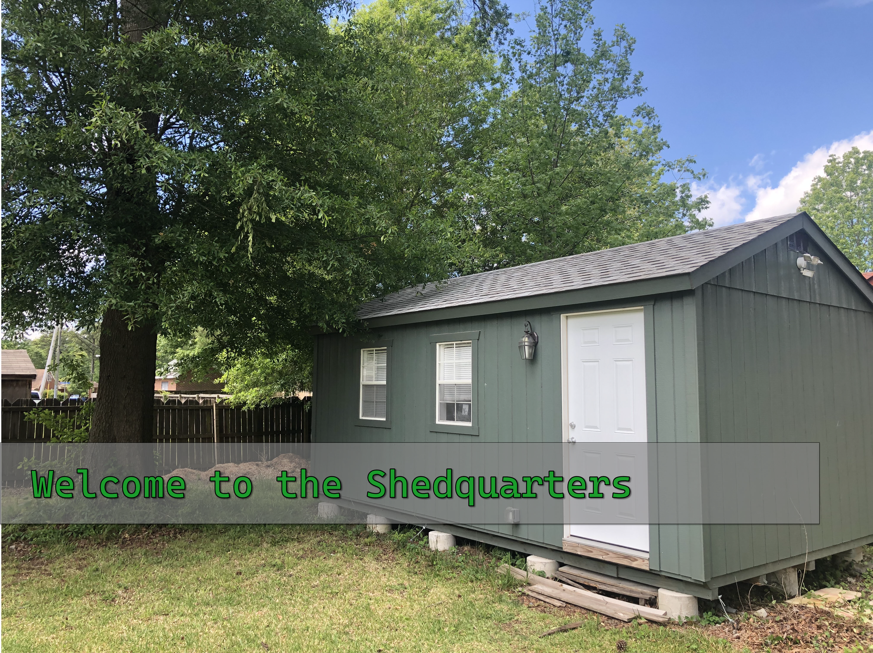

Slide 4
All details for THIS talk at:
https://consultwithgriff.com/vue-services-plugins/

Slide 5
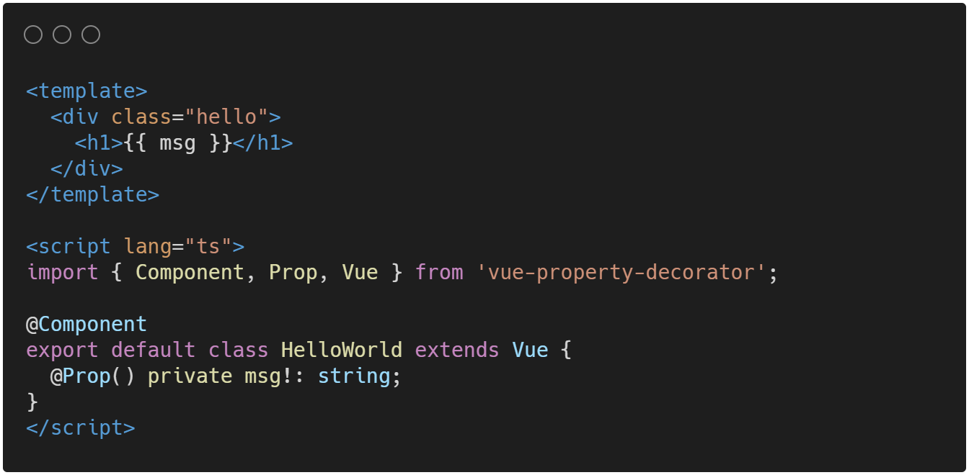
Components are Self-Contained

Slide 6
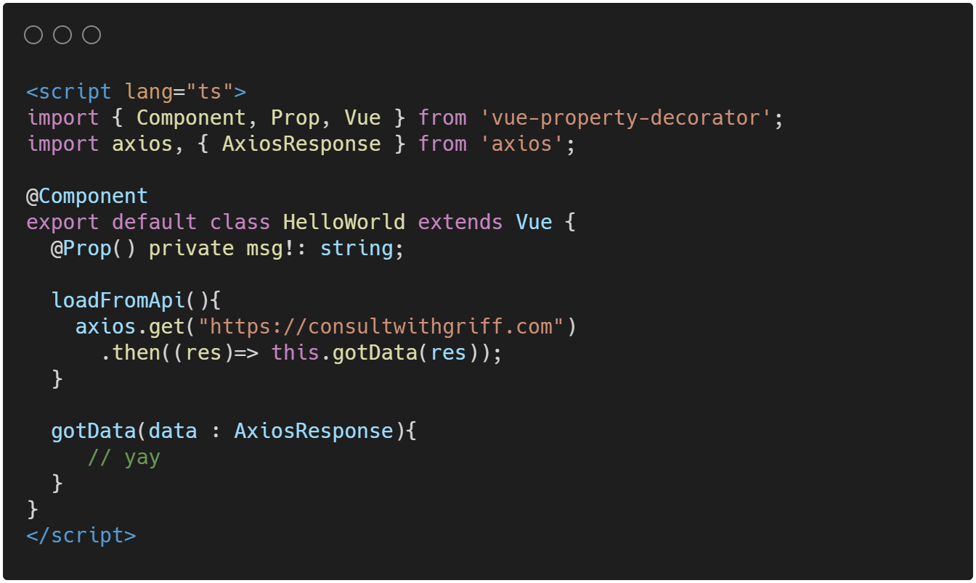
Components Can Do Stuff

Slide 7
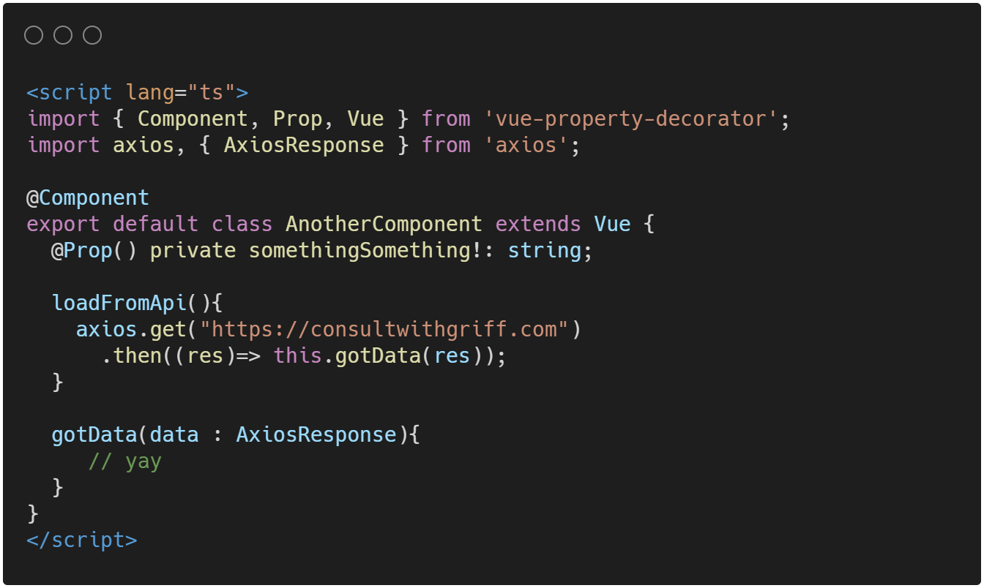
What If Components Need The Same Stuff?

Slide 8
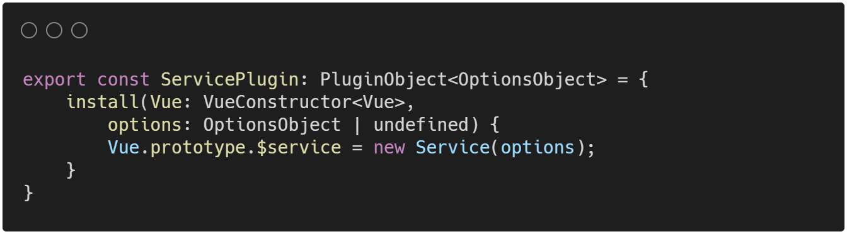
Let’s Build A Plugin!
Notes:
https://carbon.now.sh/?bg=rgba(255%2C255%2C255%2C1)&t=vscode&wt=bw&l=application%2Ftypescript&ds=false&dsyoff=20px&dsblur=68px&wc=true&wa=false&pv=0px&ph=0px&ln=false&fl=1&fm=Hack&fs=14px&lh=133%25&si=false&es=2x&wm=false&code=export%2520const%2520ServicePlugin%253A%2520PluginObject%253COptionsObject%253E%2520%253D%2520%257B%250A%2520%2520%2520%2520install(Vue%253A%2520VueConstructor%253CVue%253E%252C%2520%250A%2520%2520%2520%2520%2520%2520%2520%2520options%253A%2520OptionsObject%2520%257C%2520undefined)%2520%257B%250A%2520%2520%2520%2520%2520%2520%2520%2520Vue.prototype.%2524service%2520%253D%2520new%2520Service(options)%253B%250A%2520%2520%2520%2520%257D%250A%257D

Slide 9
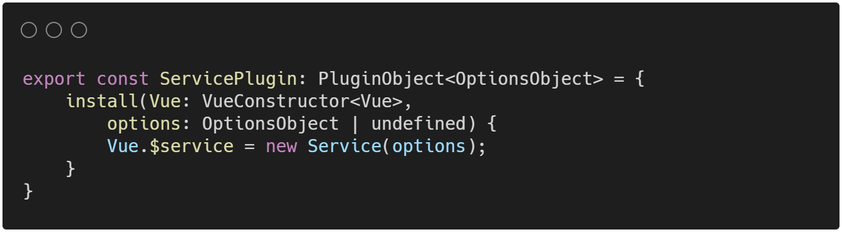
Or
Notes:
https://carbon.now.sh/?bg=rgba(255%2C255%2C255%2C1)&t=vscode&wt=bw&l=application%2Ftypescript&ds=false&dsyoff=20px&dsblur=68px&wc=true&wa=false&pv=0px&ph=0px&ln=false&fl=1&fm=Hack&fs=14px&lh=133%25&si=false&es=2x&wm=false&code=export%2520const%2520ServicePlugin%253A%2520PluginObject%253COptionsObject%253E%2520%253D%2520%257B%250A%2520%2520%2520%2520install(Vue%253A%2520VueConstructor%253CVue%253E%252C%2520%250A%2520%2520%2520%2520%2520%2520%2520%2520options%253A%2520OptionsObject%2520%257C%2520undefined)%2520%257B%250A%2520%2520%2520%2520%2520%2520%2520%2520Vue.%2524service%2520%253D%2520new%2520Service(options)%253B%250A%2520%2520%2520%2520%257D%250A%257D

Slide 10
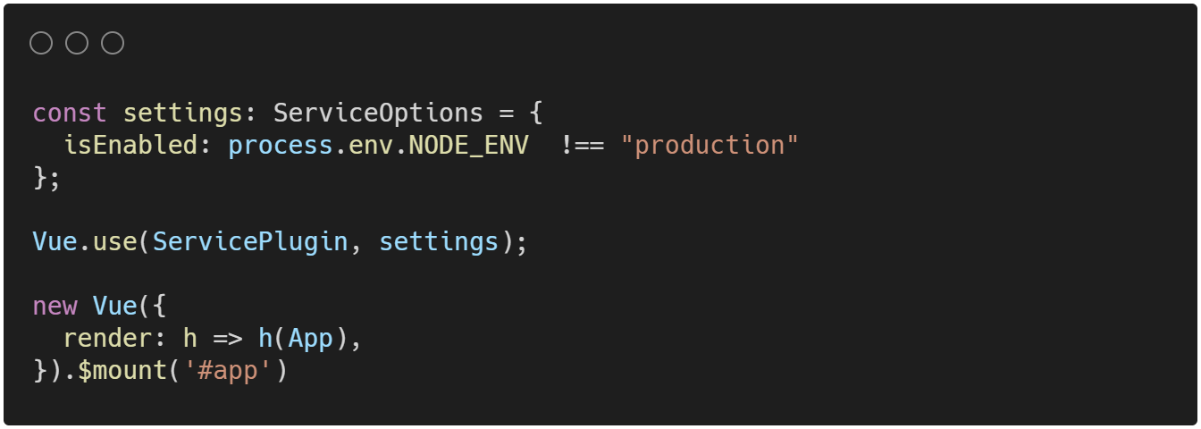
Let’s Install The Plugin!
Notes:
https://carbon.now.sh/?bg=rgba(255%2C255%2C255%2C1)&t=vscode&wt=bw&l=application%2Ftypescript&ds=false&dsyoff=20px&dsblur=68px&wc=true&wa=false&pv=0px&ph=0px&ln=false&fl=1&fm=Hack&fs=14px&lh=133%25&si=false&es=2x&wm=false&code=const%2520settings%253A%2520ServiceOptions%2520%253D%2520%257B%250A%2520%2520isEnabled%253A%2520process.env.NODE_ENV%2520%2520!%253D%253D%2520%2522production%2522%250A%257D%253B%250A%250AVue.use(ServicePlugin%252C%2520settings)%253B%250A%250Anew%2520Vue(%257B%250A%2520%2520render%253A%2520h%2520%253D%253E%2520h(App)%252C%250A%257D).%2524mount(%27%2523app%27)

Slide 11
Less Talk, More Code
Let’s build the “logger” example

Slide 12
Thanks!
Kevin Griffin
twitter.com/1kevgriff
consultwithgriff.com

